Slide 1
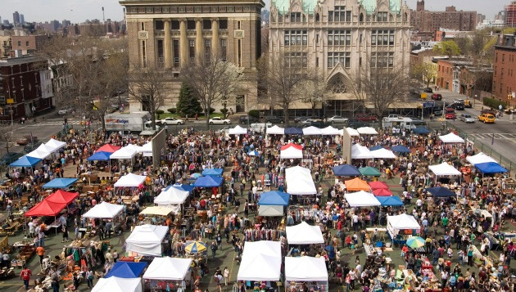
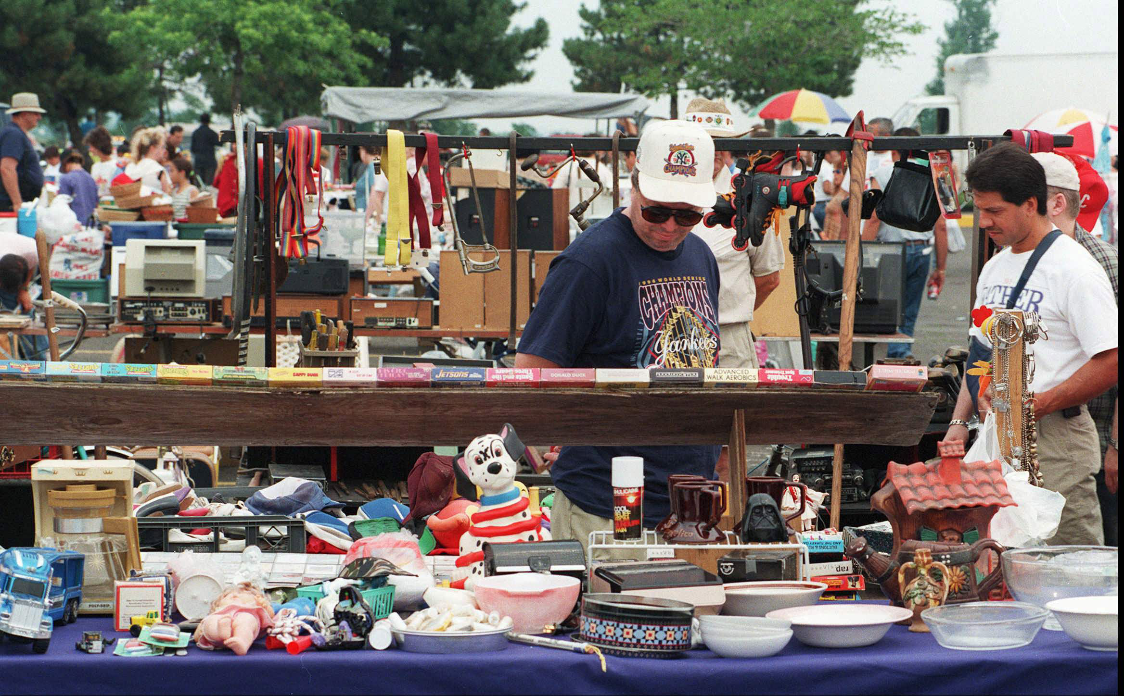
Flea Market
Ajay Chinthalapalli Jayakumar (axc142430)
Lun Xiao (lxx141130)
Shashank Kumar Shankar (sxs141731)

Slide 2
Introduction
Our project is to maintain the database of stalls spaces in a Flea Market.
A Flea Market is a type of market that rents space to people who want to sell or exchange goods. The goods here can be High quality, low quality or Used goods.

Slide 3
Who uses this database?
This database is mainly used by the Managers of a Flea Market to maintain the stall’s rent, information of renter, objects sold in the stalls, maintenance staff etc.

Slide 4
Features in our Flea Market Design
People can rent a stall and sell various items.
The items sold can be cloths, Electronic items or food.
Stalls are rented based on the area of the stall required.
The payment options for the rent can be daily or weekly.
Booth can only be assigned only after payment.

Slide 5
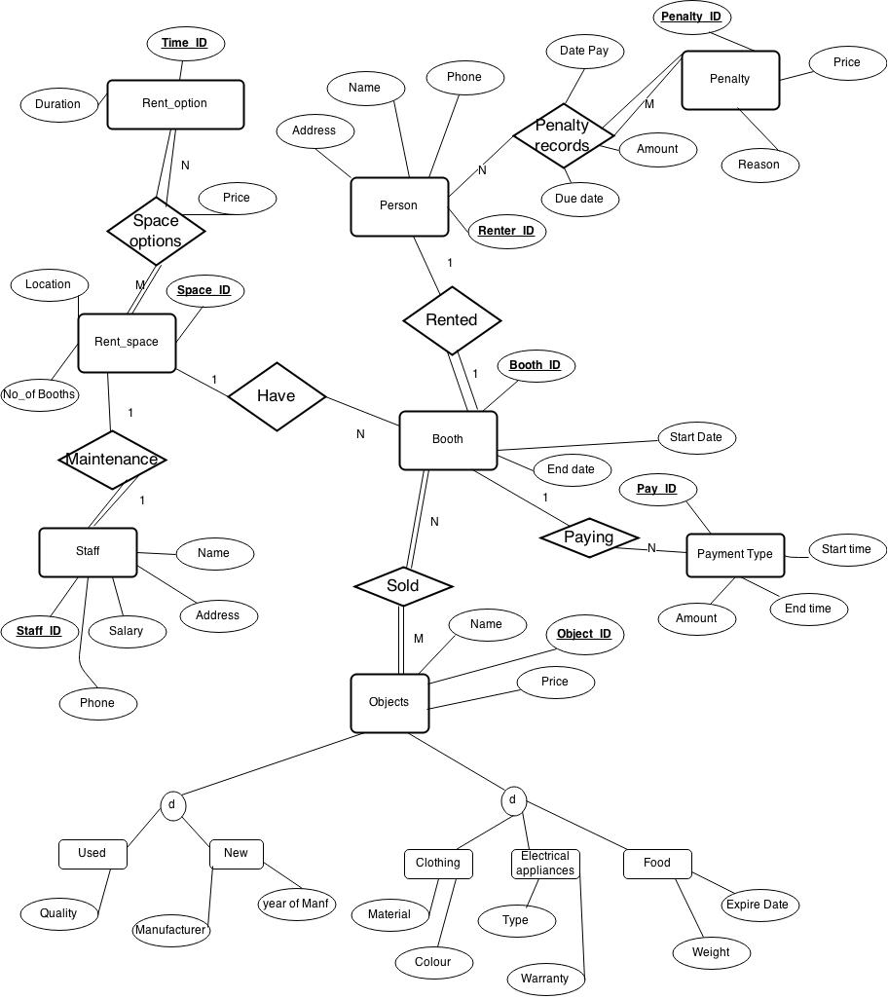
ER Diagram

Slide 6
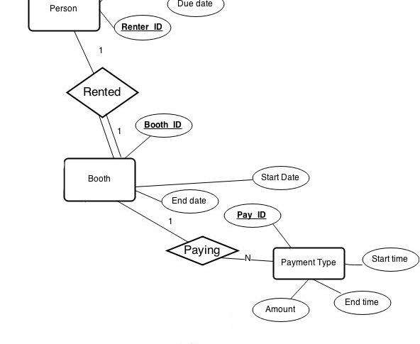
ER Diagram explanation.
A Booth/Stall can be rented by any person. Details of the stall is determined by the booth entity.
The payment options for the booth can be paid using cash, card or cheque.

Slide 7
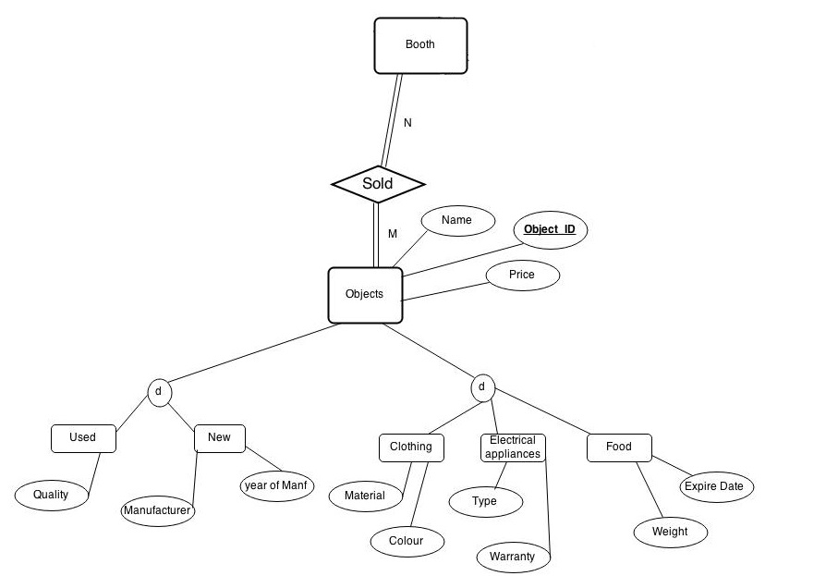
ER Diagram explanation (contd…)
The objects sold at each stall can be either Used goods or Newly manufactured.
Each stall can sell either Cloths, Electronic Appliances and food.

Slide 8
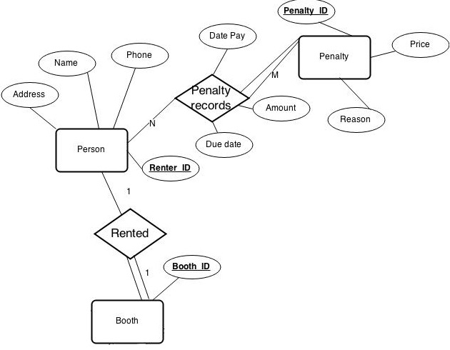
ER Diagram explanation (contd…)
The details of the person who rents the Booth space is in the entity Person.
Also, the penalty a renter pays is also included. The penalties maybe due to low maintenance etc.

Slide 9
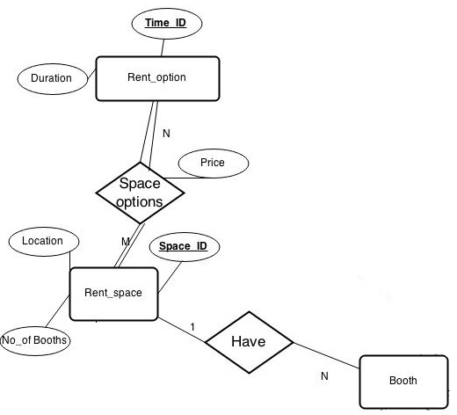
ER Diagram explanation (contd…)
Each Booth/Stall falls in a particular rent space category based on the area of the stall/booth rented.
Rent price for Large area booths is higher than medium and small area booths.
Each type of rent space have particular number of Booths in them.

Slide 10
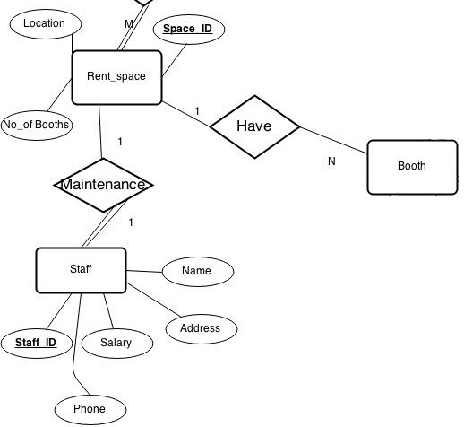
ER Diagram explanation (contd…)
Each rent space is maintained by a staff person.
The staff can help renters in setting up the shops, cleaning, preparing the rent space for new renters.

Slide 11
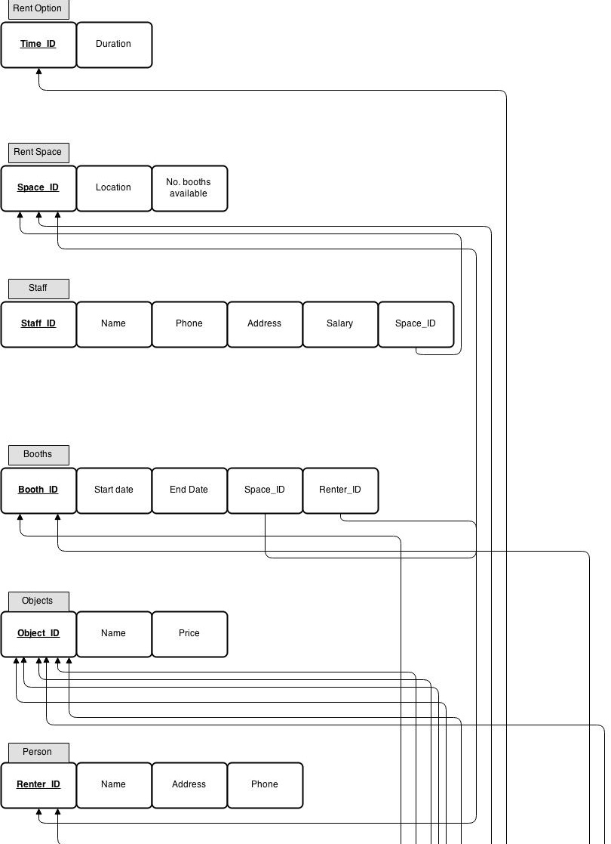
Relational Schema

Slide 12
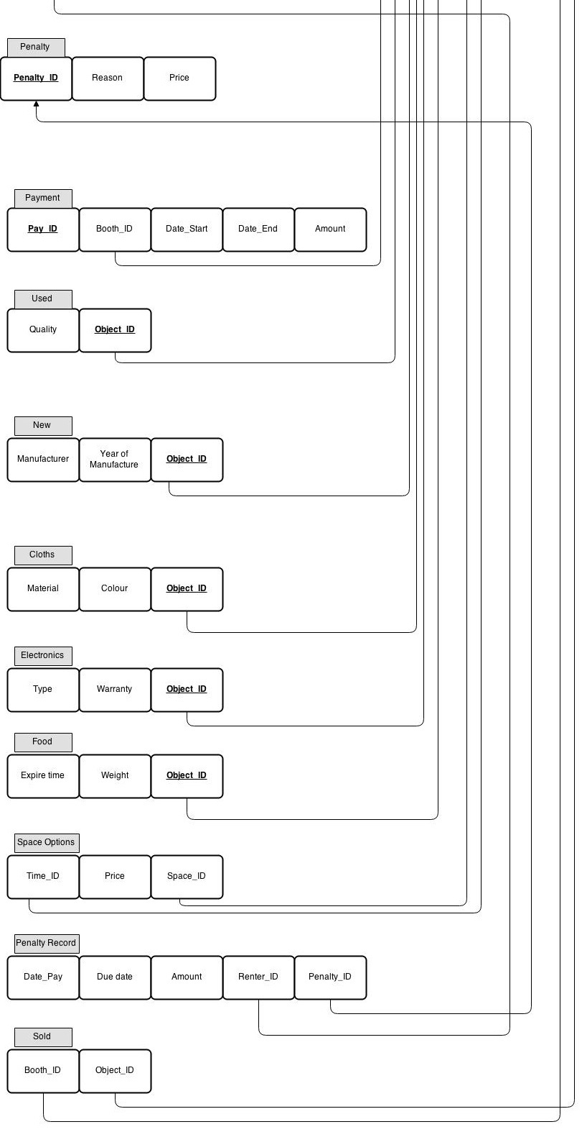
Relational Schema (Contd…)

Slide 13
Thank you.

